Slide 1
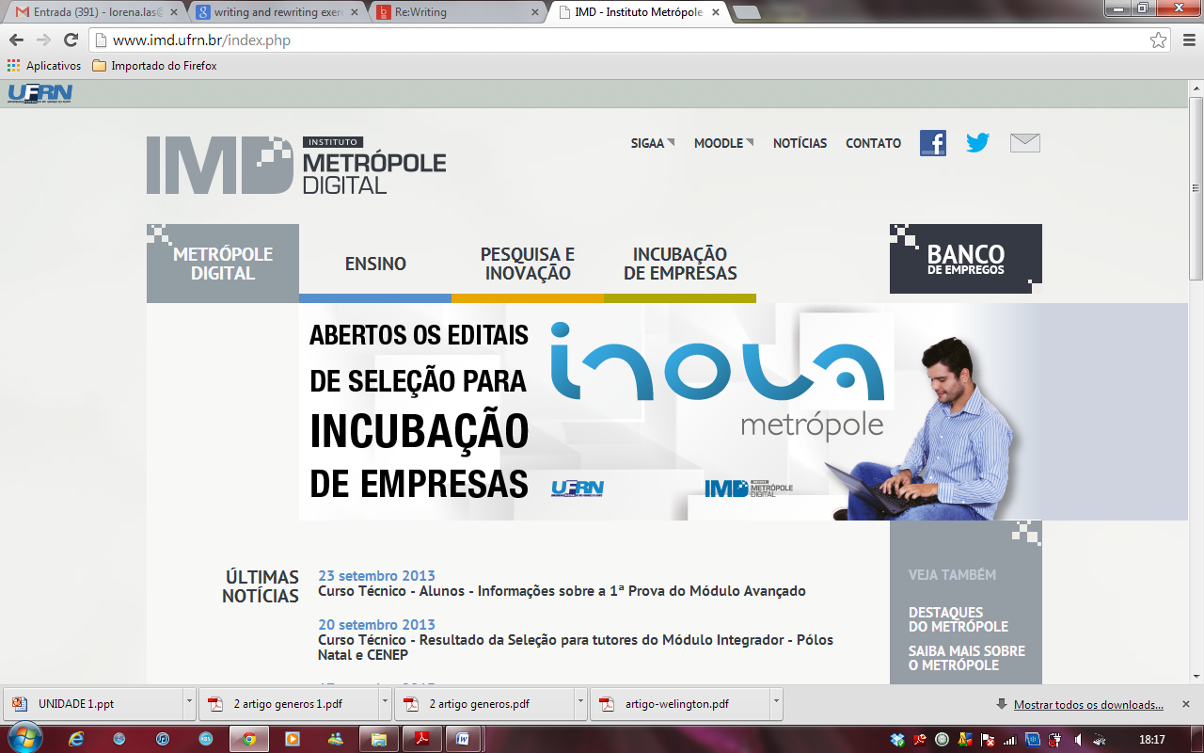
UNIVERSIDADE FEDERAL DO
RIO GRANDE DO NORTE
INSTITUTO METRÓPOLE DIGITAL
Bacharelado em Tecnologia da Informação
Disciplina:Práticas de Leitura em Inglês
Professor: Wagner Kerller
Aula 7

Slide 2
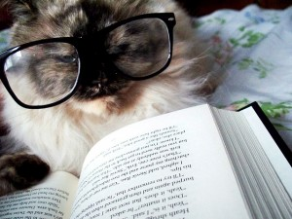
READING STRATEGY

Slide 3
What are cognates?
Cognatas são palavras de uma língua estrangeira que, além de parecidas na forma, são também parecidas no significado com palavras do português.
A língua inglesa possui várias palavras desse tipo, geralmente derivadas do latim ou do grego.

Slide 4
Cognates
1.idênticas: radio, piano, hospital, hotel, sofa, nuclear, social, total, particular, chance, camera, inventor...
2.parecidas: gasoline, banks, inflation, intelligent, population, revolution, commercial, attention, different, products, secretary, billion, dramatic, deposits, distribution, automatic, television, public, events, models, electricity, responsible, explain, activity, impossible, company...

Slide 5
Actually (actual, existing fact) — Atualmente (nowadays, today)
Anticipate (expect, look forward to) — Antecipar (to bring forward,
to move forward)
Assist (to give support, aid to) — Assistir (to watch)
Balcony (balustraded, railed elevated platform) — Balcão (counter)
Contest (competition, dispute) — Contexto (context)
Costume (worn on the stage or at balls) — Costume (custom, habit)
Data (individual facts, statistics) — Data (date)
Design (especially to plan the form and structure) — Designar (to appoint)
Educated (displaying qualities) — Educado (with a good upbringing,
well-mannered, polite)
Enroll (register, to put in a record) — Enrolar (to roll, to wind, to curl)
Exit (a way or passage out) — Êxito (success)

Slide 6
Expert (a person who has special skill or knowledge) —
Esperto (smart, clever)
Fabric (a cloth made by weaving, knitting) — Fábrica (plant, factory)
Injury (harm or damage) — Injúria (insult)
Legend (a nonhistorical or unverifiable story) — Legenda (subtitle)
Library (a place to contain books) — Livraria (book shop)
Lunch (a light midday meal between breakfast and dinner) —
Lanche (snack)
Novel (fictitious narrative of considerable length and complexity) —
Novela (soap opera)
Office (a room or set of rooms for a business or professional organisation) —
Oficial (official)
Parents (a father or a mother) — Parentes (relatives)

Slide 7
Particular (distinguished or different, exceptional, especial) —
Particular (personal, private)
Push (to press upon or against (a thing)) — Puxe (to pull)
Pull (to draw or haul toward oneself or itself) — Pular (to jump)
Record (to cause to be set down or registered) —
Recordar (to remember, to recall)
Refrigerant (a cooling substance) — Refrigerante (soft drink)
Service (an act of helpful activity, the providing or a provider) —
Serviço (job)
Stranger (person with whom one has no personal acquaintance) —
Estrangeiro (foreigner)
Tax (sum of money demanded by a government) — Taxa (rate, fee)

Slide 8
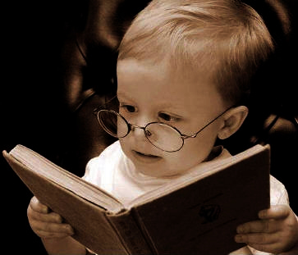
READING 1

Slide 9
Information and Communication Technologies (ICT)
ICT refers to technologies that provide access to information through telecommunications. It is similar to Information Technology (IT), but focuses primarily on communication technologies. This includes the Internet, wireless networks, cell phones, and other communication mediums.

Slide 10
Information and Communication Technologies (ICT)
In the past few decades, information and communication technologies have provided society with a vast array of new communication capabilities. For example, people can communicate in real-timewith others in different countries using technologies such as instant messaging, voice over IP (VoIP), and video-conferencing. Social networking websites like Facebook allow users from all over the world to remain in contact and communicate on a regular basis.

Slide 11
Information and Communication Technologies (ICT)
Modern information and communication technologies have created a "global village," in which people can communicate with others across the world as if they were living next door. For this reason, ICT is often studied in the context of how modern communication technologies affect society.

Slide 12
Information and Communication Technologies (ICT)
1.Transcreva do texto 10 palavras cognatas parecidas.
2.Transcreva do texto 5 palavras cognatas idênticas.
3.Há, no texto, algum falso cognato?

Slide 13
Information and Communication Technologies (ICT)
O que são TICs?
Qual a diferença entre TICs e TI?
Que tecnologias possibilitam que pessoas em diferentes países se comuniquem em tempo real?
O que o facebook permite?
O que é global village?
Em que contexto as TICs são geralmente estudadas?

Slide 14
READING 2

Slide 15
10 Upcoming Technology
That May Change The World
http://www.hongkiat.com/blog/revolutionary-products/

Slide 16
10 Upcoming Technology That
May Change The World
We have seen great leaps in digital technology in past the past five years. Smartphones, cloud computing, multi-touch tablets, these are all innovations that revolutionized the way we live and work. However, believe it or not, we are just getting started. Technology will get even better. In the future, we could live like how people in science fiction movies did.

Slide 17
http://www.eslgamesplus.com/future-forms-review-spin/

